Slide 1

Amazon Phone Sales Dashboard: Insights, Trends & Strategy
This report explores sales, pricing, and discount strategies for Amazon tech products. We highlight key metrics, badge impacts, and brand performance to guide business decisions and boost revenue.

Slide 2

Key Metrics Overview
315
Total Products
4.08
Avg Star Rating
144,300
Total Sales
$22.6M
Total Revenue

Slide 3
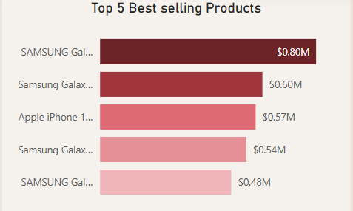
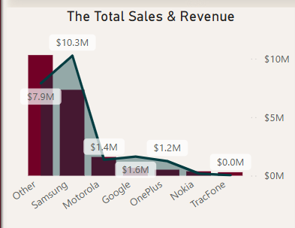
Brand Performance Insights
Samsung
Leads with $10.25M revenue
Other Brands
$7.89M revenue
Google
$1.63M revenue
Motorola
$1.35M revenue

Slide 4
Brand Performance Insights
Samsung
Leads with $10.25M revenue
Samsung accounts for a significant portion of the market.
Recommended to prioritize Samsung in promotional strategies
due to strong consumer demand.
• Focusing on high-performing brands and exploring
cross-selling opportunities. Leverage popular brands to upsell products.

Slide 5

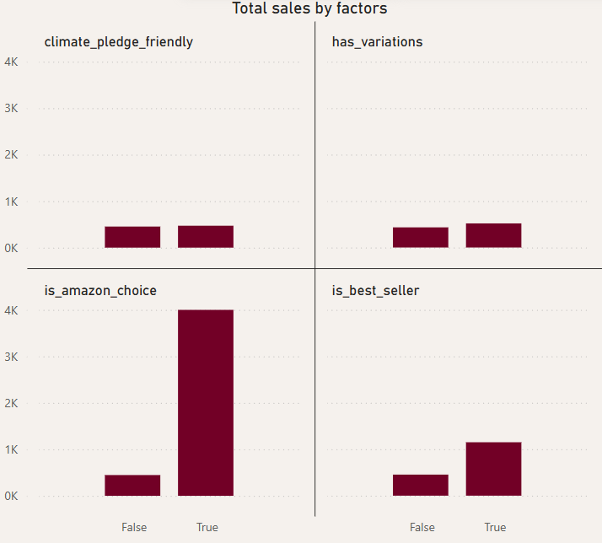



Impact of Amazon Badges
Best Seller
2 products, high sales per product.
Amazon Choice
1 product, highest sales per product.
Climate Friendly
11.94% of products, moderate sales impact.

Slide 6
Impact of Amazon Badges
These badges are rare but significantly impact sales and revenue.
For example, Amazon Choice products, though only
a small percentage shows much higher sales per product

Slide 7

Discounts and Sales Performance
Discounts
Optimal Range
Steep discounts do not guarantee higher sales.
In some cases, extremely discounted products underperform.
Moderate discounts (10%-30%) perform best in price-sensitive segments instead of blanket deep cuts.
Recommendation
• Monitor competitor pricing and adjust offers to remain competitive.
• Perform A/B testing of pricing strategies within
10%-30% discount range.

Slide 8
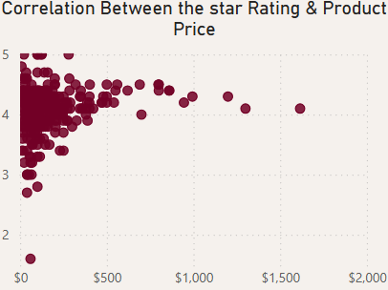
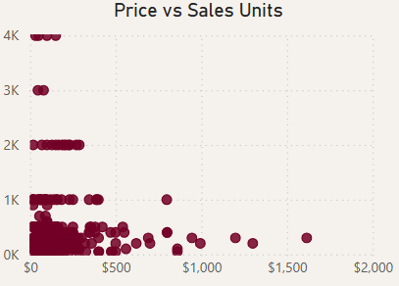
Price Range & Sales Volume
The highest sales volumes are concentrated in the $0–$500 price range.
Price vs Sales Units: Most products with high unit sales are priced below $500.
Price vs Rating: Well-rated products are also predominantly within this price bracket.
Insight: Budget and mid-range phones dominate consumer interest, while premium-priced phones see significantly lower volume.

Slide 9

Price Range & Sales Volume
Recommendations:
Focus marketing, promotions, and inventory stocking within the $0–$500 range
Position higher-priced phones as luxury or flagship offerings with enhanced features or bundles to justify pricing.
Introduce more competitive products in the $200–$500 sweet spot for volume and margin balance.

Slide 10

Shipping & Prime Influence
Prime Products
Free Delivery
Action
228 products currently have Prime eligibility, representing the majority of high performers in terms of sales. Prime status significantly boosts product visibility and customer trust, encouraging faster purchase decisions.
An overwhelming 95.2% of total revenue is generated from items offering free delivery, underscoring the critical role that no-cost shipping plays in customer satisfaction and conversion rates.
Customers are more likely to complete a purchase when shipping costs are not a concern, making this a key factor in sales strategy.
To leverage these advantages, it is essential to optimize product listings to qualify for Amazon Prime and emphasize free shipping options. Enhancing logistics partnerships and streamlining supply chains can help maintain these benefits and improve overall performance..

Slide 11
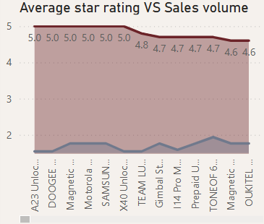
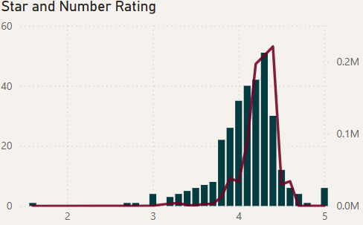
Customer Perception and Ratings
Trend Detected: While many products showcase perfect 5-star ratings, they often lack a substantial number of reviews—raising concerns about authenticity and buyer confidence.
Reliable Trust Indicator: Products with ratings in the 4.2–4.5 range paired with a high volume of reviews are more dependable indicators of customer satisfaction and are more likely to influence purchasing decisions.

Slide 12
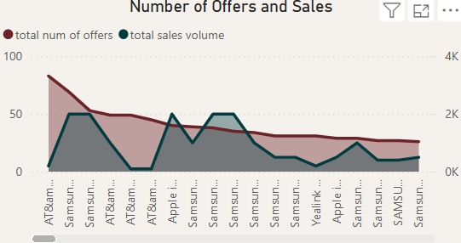
Customer Perception and Ratings
Higher number of offers ≠ Higher sales: while many products showcase a good total of sales, it does not have a strong, visible correlation with the number of offers.
With a higher number of offers, the sales don’t get significantly affected with a positive change.

Slide 13



Customer Perception and Ratings
In Summary:
Trust Range
4.2–4.5 stars with many reviews build trust.
High Ratings
Recommendation
2
5.0 stars often have few reviews.
Encourage verified reviews via email campaigns.
1
3

Slide 14

Strategic Recommendations
Test Discounts
1
Run controlled experiments with discount percentages—perhaps using A/B testing on your website or targeted promotions—to validate if higher discounts consistently drive more sales. Use these insights to refine your pricing strategy.
Monitor Margins
While higher discounts may drive sales volume, they can also reduce your profit margins. Evaluate whether the increased volume compensates for the lower margin per product.
2

Slide 15
Strategic Recommendations
Segment Products
Different products might respond differently to discounting. For example, flagship models might sell well even with lower discounts, while budget models might require higher discounts to move. Segment your products and analyze them separately to fine-tune your strategy.
3
Integrate Metrics
Integrate customer ratings, review counts, and badge data (like Amazon’s Choice or Best Seller) with your discount analysis. For instance, products with high ratings and mid-range discounts might be your best performers, indicating a strong overall value proposition.
4

Slide 16
Thanks

